Slide 1
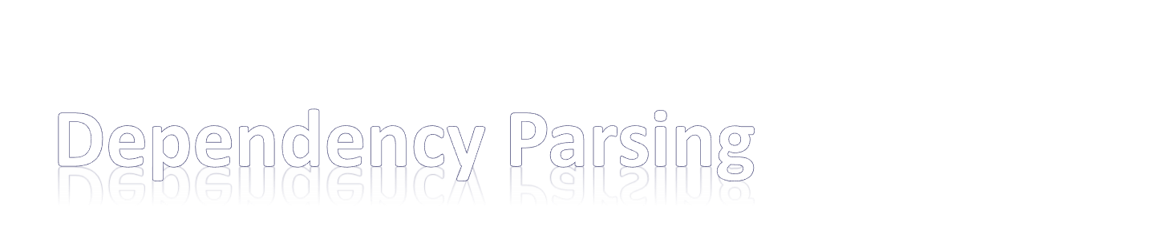
Wenjing Fang (Bean)
littlebeanfang@sjtu.edu.cn
Notes:
1. Greeting and Self introduction
2. Both about research and project. Preprocess data: information extraction & QA & mining, ) and improving the accuracy. Make computer understand our language, which inspire me to do research about it. just give out a general idea about the dependency parsers, not in detail.
Candy rule~

Slide 2

Motivation and Introduction
Graph-based: MST parser
Transition-based: Malt parser
Converting tool : Stanford parser
Summary

Slide 3
Motivation and Introduction
Graph-based: MST parser
Transition-based: Malt parser
Converting tool : Stanford parser
Summary

Slide 4

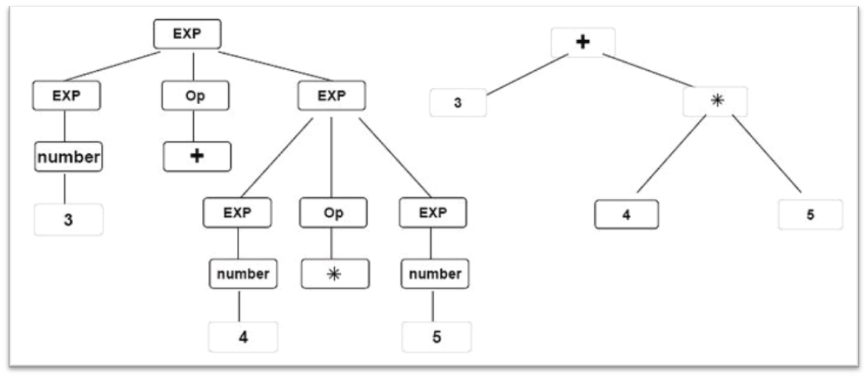
Survey: parse
Task:
  Input: Raw text → Output: Syntax tree
  3+4*5
Notes:
What is parsing?
survey: how many of you have used of heard of dependency parsing ? How many of you have learned or is learning compiler course (one of the steps of compiler: syntax tree or parse tree [pic], difference: here the language is natural language or human language[difficulty: rules and ambiguity])?
Give a intuition by an example picture

Slide 5

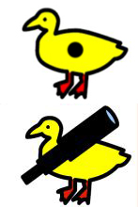


Survey: parse
Task:
  Input: Raw text → Output: Syntax tree
Difficulty:
  Complex natural language rules
  Ambiguity in different ways
    Word: I saw her duck.
    Attachment:
      I saw her duck with a telescope.
      I saw her duck with a dot.
Notes:
What is parsing?
survey: how many of you have used of heard of dependency parsing ? How many of you have learned or is learning compiler course (one of the steps of compiler: syntax tree or parse tree [pic], difference: here the language is natural language or human language[difficulty: rules and ambiguity])?
Give a intuition by an example picture

Slide 6

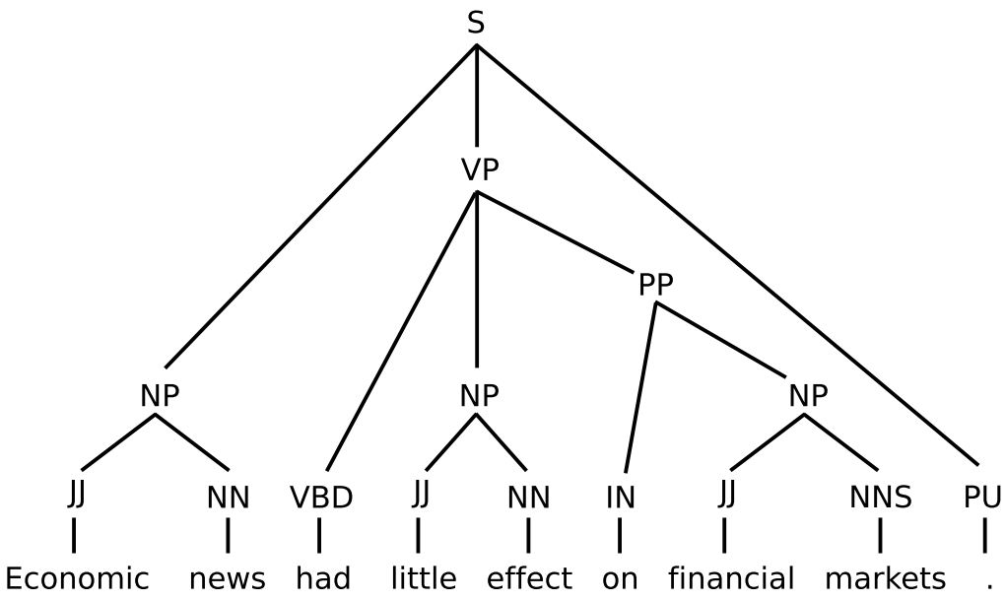
Data structure or representation
  Dependency & Phrase Structure
structural categories:
NP → noun phrase
VP → verb phrase
(governs several words)
POS tag: part-of-speech
grammatical tag. E.g.
JJ→ adj. VBD→ verb-ed
NN→ Noun, singular
Notes:
Pic of both representation
Explanation of tree structure(continen)
Pos TAG
dependency structure represents head-dependent relations between words, classified by functional categories such as subject (SBJ) and object (OBJ), the phrase structure represents the grouping of words into phrases , classified by structural categories such as noun phrase (NP) and verb phrase (VP)
govern

Slide 7
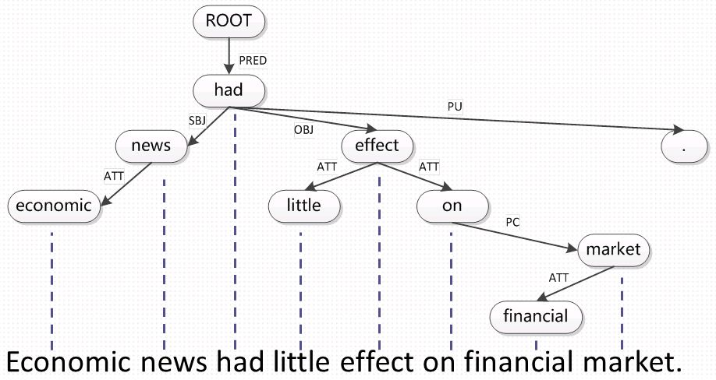
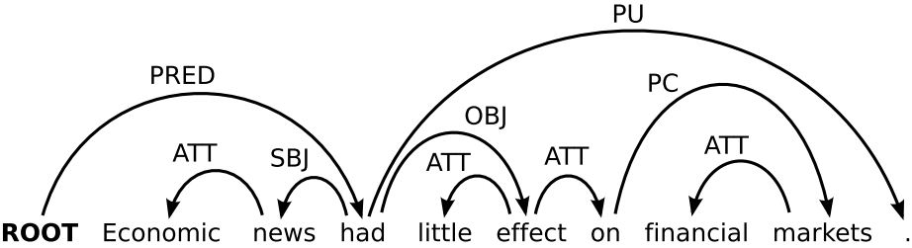
Data structure or representation
  Dependency & Phrase Structure
Words as nodes
head-dependent relations between words , classified by functional categories. E.g.
OBJ → object
Notes:
Pic of both representation
Explanation of tree structure(continen)
Pos TAG
dependency structure represents head-dependent relations between words, classified by functional categories such as subject (SBJ) and object (OBJ), the phrase structure represents the grouping of words into phrases , classified by structural categories such as noun phrase (NP) and verb phrase (VP)
govern

Slide 8

Data structure or representation
  Dependency V.S. Phrase Structure
  Advantage of dependency structure
    Less nodes
    No extra symbols
    Order free
    Word relation
Notes:
Constituency Structure
Dependency parsing didn’t introduce extra intermediate nodes and symbols , just build relations between words directly.
phrase structure divide a sentence in several continuous parts. However, In dependency parsing , Relation may be between discontinuous words.

Slide 9

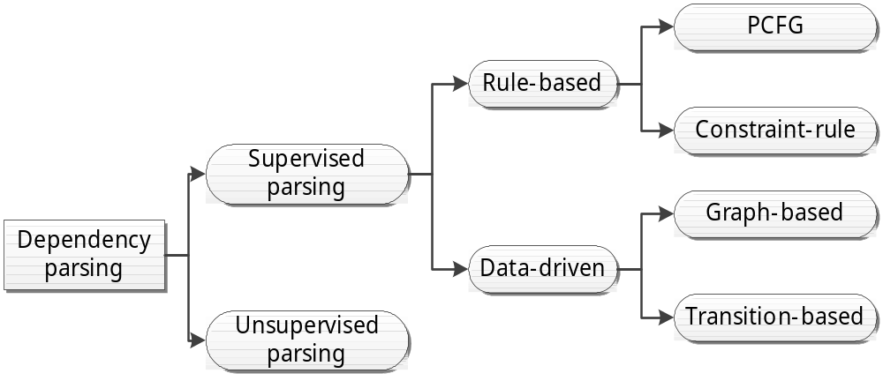
Focus:
  Graph-based
  Transition-based
  Conversion tool
Notes:
Dependency parsing is divided into supervised parsing and unsupervised parsing depending on whether there are pre-parsed data offered(this concept is from machine learning).
As referred before, natural language parsing is similar to programming language parsing, some researchers introduced rule-based methods into dependency parsing. But dependency parsing today mainly applies statistic methods, they are called data-driven parsers. They employs machine learning methods to get parsing instruction from history data.
Get statistics from history data to instruct further parsing.

Slide 10
Motivation and Introduction
Graph-based: MST parser
Transition-based: Malt parser
Converting tool : Stanford parser
Summary

Slide 11





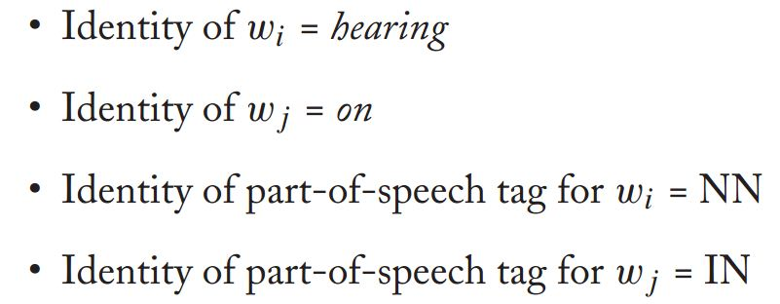
Dependency graphs = directed trees
  Graph theory
Tree scorer: arc-factor model
Score of arc:
From wi to wj
Relation is r
Weight
vector
pre-defined features
converted to binary vector
Notes:
As we can see, dependency is represent by a directed graph, then how about solve it as a graph.
Graph-based parsing assigns every word pairs a score. which measures the how like they can be a pair, the higher the better.

Slide 12
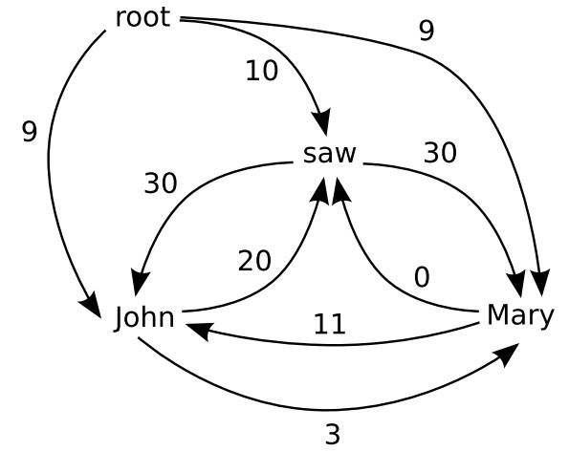
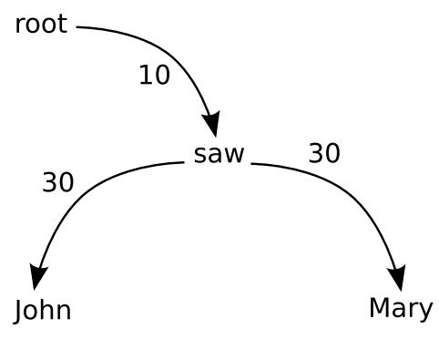

Dependency graphs = directed trees
  Graph theory
Tree scorer: arc-factor model
maximum spanning tree(MST parser)
Notes:
So we can get a tree of highest sum of arc-scores, which is called maximum spanning tree problem in graph theory. There’re many algorithms can deal with this problem. And this is the key idea of this kind of parser.

Slide 13
Motivation and Introduction
Graph-based: MST parser
Transition-based: Malt parser
Converting tool : Stanford parser
Summary
Notes:
Next transition-based parsr

Slide 14

DFA: deterministic finite automaton
States + transitions → graph
Example:
  String : ab*c
  Input :
    a b b b c √
    a b a a c X
b
Start
a
S1
c
End
Notes:
Survey: how many of you know what is DFA, what problem can it solve?
We can turn a regex into a map, and according to the input string to judge if it can accept by DFA. DFA is consist of states and transitions, accept a string which reach the accept states.
This simple DFA stands for regex “ab*c”, it walk through a “a” character then several “b”s, and end with c. Obviously, from the DFA, first input string is contained in the regex, and for the second string, there’s arrow “a”out from S1 state, so DFA will return an error, it’s not accepted.

Slide 15
More complex state + well-defined transitions
3 data structures:
  Stack σ: partially processed words
  Buffer β: remaining input words
  Arc-set A: partially built dependency tree
Notes:
Transition-based parser is inspired by DFA, but it contains more complex states and well-pre-defined transitions.
The State(or called configuration) of Transition-based parser is consisted of 3 data structures . Intro

Slide 16
More complex state + well-defined transitions
3 data structures: Stack σ, Buffer β, Arc-set A
Configuration for a sentence S = w0,w1,…,wn:
  Triple c=(σ, β, A) arc in A (wi, r, wj)
Notes:
The State(or called configuration) of Transition-based parser is consisted of triple of these 3 data structure.

Slide 17
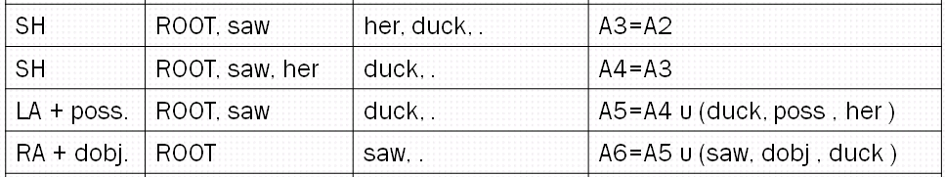
More complex state + well-defined transitions
3 data structures: Stack σ, Buffer β, Arc-set A
Configuration: Triple c=(σ, β, A)
Transition:
  Left-Arc_{r}: (α|w_{i} , w_{j}|β, A)➔ (α , w_{j}|β, A∪{( w_{j}, r, w_{i})})
  Right-Arc_{r}: (α|w_{i} , w_{j}|β, A)➔ (α , w_{i}|β, A∪{( w_{i}, r, w_{j})})
  Shift: (α, w_{i}|β, A) ➔(α|w_{i}, β, A)
Notes:
Transition here is defined as some action on 3 data structures.(+++pic of action)
For example, the default action is shift same in shift-reduce parser(survey).move one word from buffer to stack.
left-arc r means I build a relation r between wi on top of stack α and front of input buffer β. The related action as you can see, wi is pop , A contains a new relation arc (wj, r, wi).
As for right-arc r here, build right arrow relation , then delete word wj and move wi on top of stack back to buffer.
The author of Malt parser had proved these 3 transitions can lead to a dependency tree for every sentence, you can have a look if you’re interested in it.

Slide 18
ROOT I saw her duck .
Transition | α | β | A
INI | ROOT | I, saw, her, duck, . | A0 = Ф
SH | ROOT, I | saw, her, duck, . | A1=A0
LA + nsubj. | ROOT | saw, her, duck, . | A2=A1 υ (saw, nsubj , I )
SH | ROOT, saw | her, duck, . | A3=A2
SH | ROOT, saw, her | duck, . | A4=A3
LA + poss. | ROOT, saw | duck, . | A5=A4 υ (duck, poss , her )
RA + dobj. | ROOT | saw, . | A6=A5 υ (saw, dobj , duck )
SH | ROOT, saw | . | A7=A6
RA + punc. | ROOT | saw | A8=A7 υ (saw, punc , . )
RA + root |  | ROOT | A9=A8 υ (ROOT, root , saw )
SH | ROOT |  | A10 =A9
  Left-Arc_{r}: (α|w_{i} , w_{j}|β, A)➔ (α , w_{j}|β, A∪{( w_{j}, r, w_{i})})
  Right-Arc_{r}: (α|w_{i} , w_{j}|β, A)➔ (α , w_{i}|β, A∪{( w_{i}, r, w_{j})})
  Shift: (α, w_{i}|β, A) ➔(α|w_{i}, β, A)
Notes:
Here is an example for malt parser.

Slide 19


How we get the transitions ?
  Classifier + feature
What are the features ?(e.g. step 5, 6)
α | β | A
ROOT, saw | duck, . | A5=A4 υ (duck, poss , her )
ROOT | saw, . | A6=A5 υ (saw, dobj , duck )
Feature table
fi | Address | Attribute
1 | STK[0] | POS
2 | BUF[0] | POS
3 | STK[0] | FORM
4 | LDEP(STK[0]) | DEPREL
5 | RDEP(STK[0]) | DEPREL
6 | LDEP(BUF[0]) | DEPREL
7 | RDEP(BUF[0]) | DEPREL
Feature table
 | f1 | f2 | f3 | f4 | f5 | f6 | f7
f(c5)= | VBG | NN | saw | nsubj | NULL | poss | NULL
f(c6)= | ROOT | VBG | ROOT | NULL | NULL | nsubj | NULL
Classifier
Transition
LA + dobj.
SH
Notes:
Then you must raised a question, how can we get the transitions?
We can get a transition from a classifier (this is a traditional machine learning problem, not expand in detail here) depending on feature vector of each state.
For example, the possible features are list in this table.
For step 5 and 6 on the previous page, we can get the feature vectors, post them to a classifier we can get a transitions “LA+dobj.”and “SH” .

Slide 20
Motivation and Introduction
Graph-based: MST parser
Transition-based: Malt parser
Converting tool : Stanford parser
Summary

Slide 21

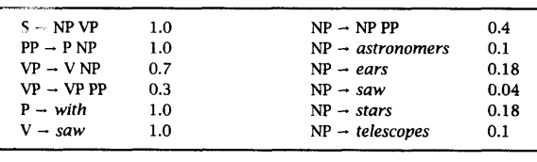
Phrase structure tree : PCFG
  Probability + CFG(context-free grammar)

Slide 22
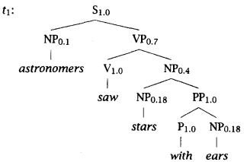
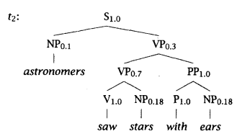

Phrase structure tree : PCFG
Example : astronomers saw stars with ears

Slide 23
Phrase structure tree : PCFG
Head rules
  Choose head of rule: X→Y1 Y2 …Yn
  Other words in subtree as dependent(child)
X
Y1
Y2
...
Yn

Slide 24
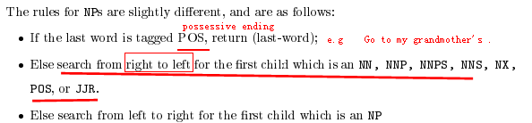


Example of head finding rules:
  Rule for NP node subtree
  Rule for S node subtree
  Rule for VP
Parent node(X)
Search from left
Priority(choose first child fits)

Slide 25
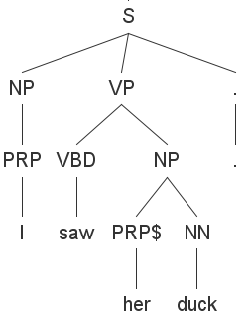
Phrase structure tree : PCFG
Head rules
  Example: I saw her duck .
duck
her

Slide 26
Phrase structure tree : PCFG
Head rules
  Example: I saw her duck .
saw
duck
her

Slide 27
Phrase structure tree : PCFG
Head rules
  Example: I saw her duck .
saw
I
duck
.
her

Slide 28
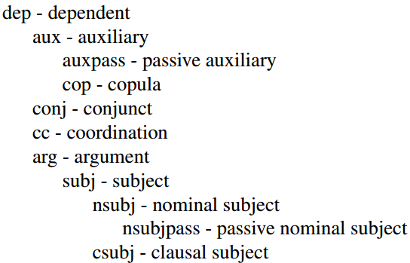
Phrase structure tree : PCFG
Head rules: get unlabeled tree
Relation :
  Relation hierarchy(a small portion)
  Pattern of each relation
saw
nsubj
punct
dobj
I
duck
.
poss
her

Slide 29
Motivation and Introduction
Graph-based: MST parser
Transition-based: Malt parser
Converting tool : Stanford parser
Summary

Slide 30

Dependency parsing: compact NL syntax tree
Graph-based parser: MST in graph theory
Transition-based parser: states+ transitions
Stanford parser:
  Phrase structure-> dependency structure

Slide 31

Q & A
Contact: littlebeanfang@sjtu.edu.cn

